Slide 1
Why Recursive Functions Halt
CS 5010 Program Design Paradigms “Bootcamp”
Lesson 4.6
© Mitchell Wand, 2016
This work is licensed under a Creative Commons Attribution-NonCommercial 4.0 International License.
TexPoint fonts used in EMF.
Read the TexPoint manual before you delete this box.: AAA

Slide 2
Introduction
All of our functions so far always terminated.
But recursive functions need not terminate!
In this lesson, we'll study a property that guarantees that a function always halts.
This property is called "having a halting measure"
We'll see how to document the halting measure for your function.

Slide 3
Learning Objectives
At the end of this lesson you should be able to:
Identify the halting measure for functions that follow a template
Document the halting measure for such functions

Slide 4
Remember lon-sum
lon-sum : LON -> Number
(define (lon-sum lst)
(cond
[(empty? lst) 0]
[else (+ (first lst)
(lon-sum (rest lst)))]))

Slide 5
Watch this work:
(lon-sum (cons 11 (cons 22 (cons 33 empty))))
= (+ 11 (lon-sum (cons 22 (cons 33 empty))))
= (+ 11 (+ 22 (lon-sum (cons 33 empty))))
= (+ 11 (+ 22 (+ 33 (lon-sum empty))))
= (+ 11 (+ 22 (+ 33 0)))
= (+ 11 (+ 22 33))
= (+ 11 55)
= 66

Slide 6
Clearly, this function will halt for any LON
Why?
Because at every step it works on a shorter and shorter list, so eventually it reaches empty? and the function halts.
In other words, (length lst) is a quantity that decreases at every recursive call.

Slide 7
So here's a hypothesis
If we can find a quantity that decreases at every recursive call to our function, then the function always halts.

Slide 8
Another example: sum
;; sum :
;; NonNegInt NonNegInt -> NonNegInt
;; strategy: use template for
;; NonNegInt on x
(define (sum x y)
(cond
[(zero? x) y]
[else (+ 1 (sum (- x 1) y))])

Slide 9
Example
(sum 3 2)
= (+ 1 (sum 2 2))
= (+ 1 (+ 1 (sum 1 2)))
= (+ 1 (+ 1 (+ 1 (sum 0 2))))
= (+ 1 (+ 1 (+ 1 2)))
= 5

Slide 10
This one will also work for any non-negative integer x
At every recursive call, the value of the first argument decreases, so eventually it reaches 0.
The value of x is a quantity that decreases at every recursive call.
So this example is consistent with our hypothesis.

Slide 11
Let's look at another example
;; foo : NonNegReal -> NonNegInt
(define (foo n)
(cond
[(zero? n) 0]
[else (+ 1 (foo (* n 0.1)))]))
This is a silly function, so we won't write out the rest of the purpose statement.

Slide 12
(foo 3)
= (+ 1 (foo 0.3))
= (+ 1 (+ 1 (foo 0.03)))
= (+ 1 (+ 1 (+ 1 (foo 0.003))))
= ...
Oops! The argument is never equal to 0, so the function never halts.

Slide 13
So we can refine our hypothesis
If we can find a integer-valued quantity that decreases at every recursive call to our function, then the function always halts.
All our examples are consistent with this hypothesis.

Slide 14
Let's try another example
;; sum2 :
;; NonNegInt NonNegInt -> NonNegInt
;; strategy: use template for
;; NonNegInt on x
(define (sum2 x y)
(cond
[(zero? x) y]
[else (+ 2 (sum2 (- x 2) y))])
What if we had used the template incorrectly, and written this program instead?

Slide 15
It still works for even x
(sum2 4 3)
= (+ 2 (sum2 2 3))
= (+ 2 (+ 2 (sum2 0 3)))
= (+ 2 (+ 2 3))
= 7

Slide 16
But watch what happens when x is odd
(sum2 3 3)
= (+ 2 (sum2 1 3))
= (+ 2 (+ 2 (sum2 -1 3)))
= (+ 2 (+ 2 (+ 2 (sum2 -3 3))))
= (+ 2 (+ 2 (+ 2 (+ 2 (sum2 -5 3)))))
= ...
Oops! The value of x went negative without being 0. This goes into an infinite loop!

Slide 17
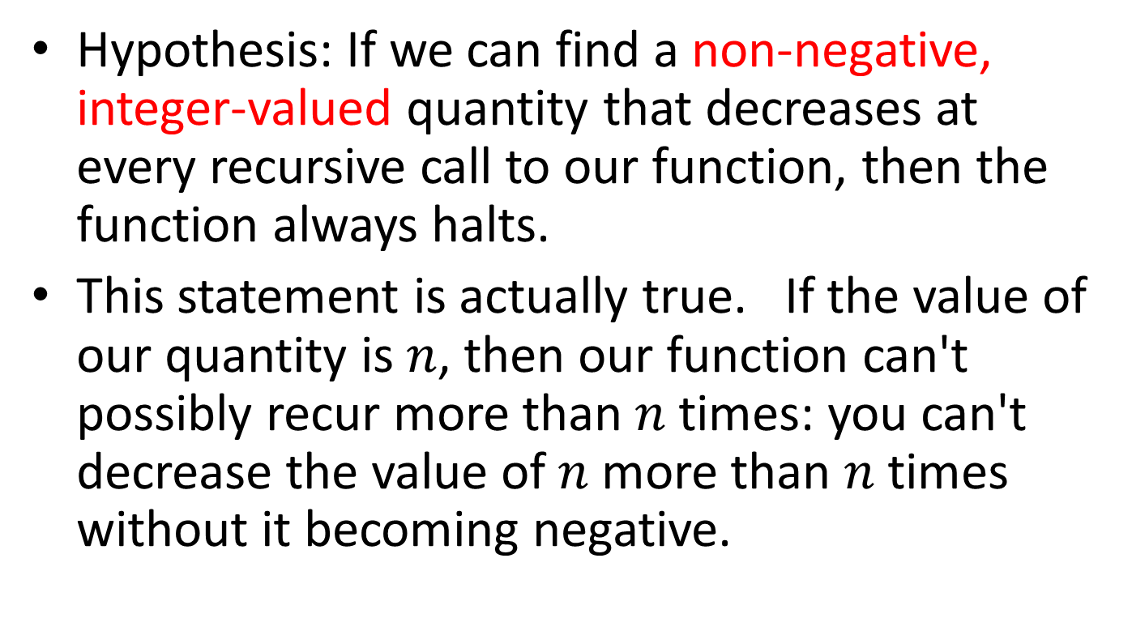
So let's refine our hypothesis again
Hypothesis: If we can find a non-negative, integer-valued quantity that decreases at every recursive call to our function, then the function always halts.
This statement is actually true. If the value of our quantity is $n$, then our function can't possibly recur more than $n$ times: you can't decrease the value of $n$ more than $n$ times without it becoming negative.

Slide 18
Halting Measure
Definition: a halting measure for a particular function is an integer-valued quantity that can't be less than zero, and which decreases at each recursive call in that function.
This is something you have probably not seen before, so you'll need to pay careful attention.

Slide 19
Examples
(length lst) is a halting measure for lon-sum
the value of x is a halting measure for sum
the value of y is a halting measure for prod (Lesson 4.4).

Slide 20
A function may have more than one halting measure
The following quantities are halting measures for sum:
the value of x
the value of x+4
the value of 2*x
The following quantities are not halting measures for sum:
the value of y
the value of -2*x
But usually there's one "obvious" halting measure, like the ones on the preceding slide.

Slide 21
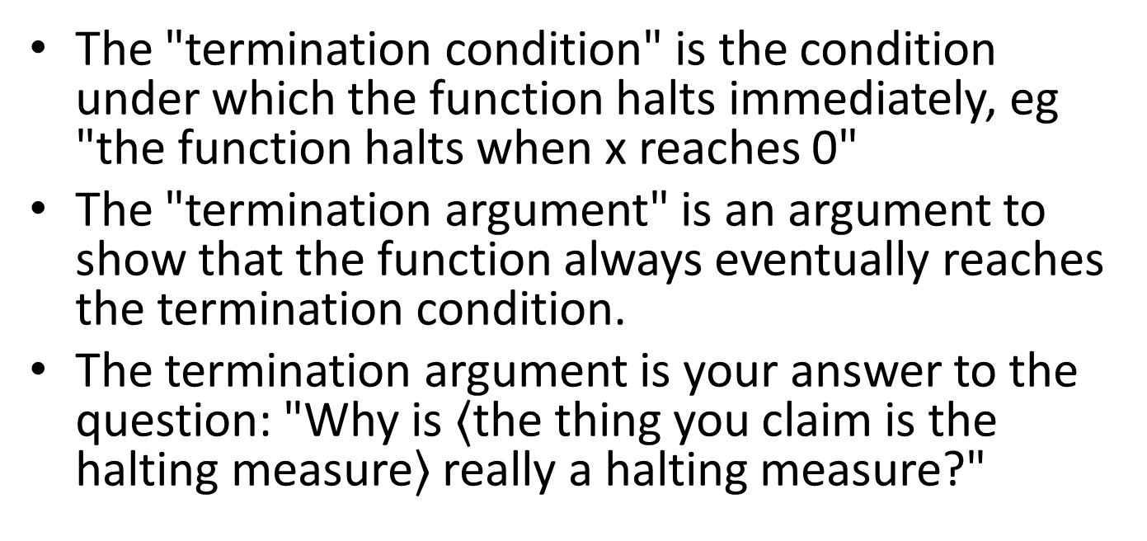
Don't get confused: "Termination Argument" vs. "Termination Condition"
The "termination condition" is the condition under which the function halts immediately, eg "the function halts when x reaches 0"
The "termination argument" is an argument to show that the function always eventually reaches the termination condition.
The termination argument is your answer to the question: "Why is $〈$the thing you claim is the halting measure$〉$ really a halting measure?"

Slide 22
The Halting Measure is a new deliverable
We will ask you to specify a halting measure for every recursive function you write.
This is usually easy, eg:
HALTING MEASURE: the length of lst
or the like.
When you follow the template, it will almost always be a quantity associated with the template variable.
The TA may ask you to explain why the thing you called the halting measure really is a halting measure for your function.

Slide 23
Summary
At the end of this lesson you should be able to:
Identify the halting measure for functions that follow a template
Document the halting measure for such functions

Slide 24
Next Steps
Study 04-XXX in the Examples file
If you have questions about this lesson, ask them on the Discussion Board
Do Guided Practice 4.4++
Go on to the next lesson
GPs: take some from Lesson 8.2, add some for lists.

